Slide 1
The Rational Unified Process
Lecturer: Ngo Huy Bien
Software Engineering Department
Faculty of Information Technology
VNUHCM - University of Science
Ho Chi Minh City, Vietnam
nhbien@fit.hcmus.edu.vn

Slide 2

Objectives
To present why and when to use RUP
To present RUP phases
To present RUP activities
To present RUP roles
To present RUP products
To apply RUP to develop a system

Slide 3

Books And Reading
Per Kroll and Philippe Kruchten (2003). The Rational Unified Process Made Easy: A Practitioner's Guide to the RUP.
Philippe Kruchten (2003). The Rational Unified Process: An Introduction.
Craig Larman (2003). Agile and Iterative Development: A Manager's Guide.

Slide 4
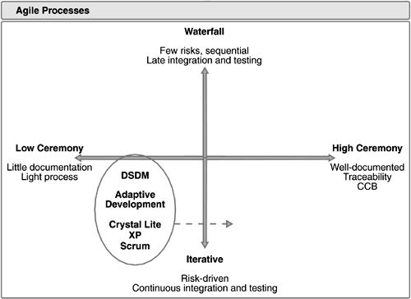


Agile Development [1]
Low-Ceremony,
Iterative Approaches
Our system is too complex.
Our developers are not competent.

Slide 5
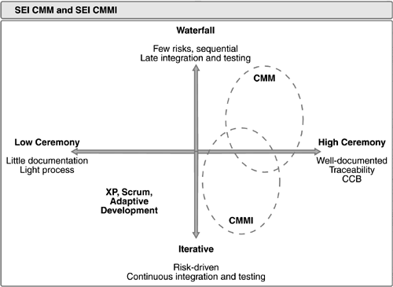
SEI CMM, SEI CMMI, ISO/IEC
High Ceremony Striving
for Higher Predictability
We do NOT have enough time and budget!

Slide 6
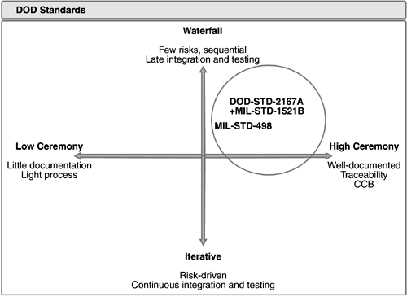
DOD-STD, MIL-STD
High Ceremony Striving
for Higher Predictability
We do NOT have enough time and budget!

Slide 7
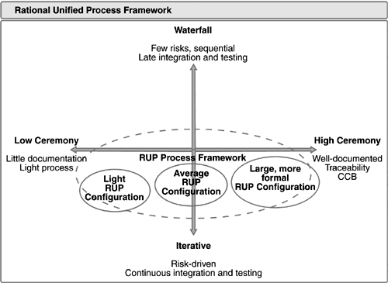
The Rational Unified Process
An Iterative Approach with an Adaptable Level of Ceremony

Slide 8
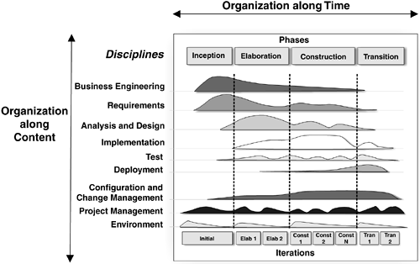
Process Structure: Two Dimensions [2]
The horizontal axis represents time and shows the lifecycle aspects of the process as it unfolds.
It represents the dynamic aspect of the process as it is enacted, and it is expressed in terms of cycles, phases, iterations, and milestones.
The vertical axis represents core process disciplines, which group activities logically by nature.
It represents the static aspect of the process: its description in terms of process components, activities, disciplines, artifacts, and roles.

Slide 9
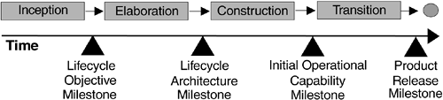
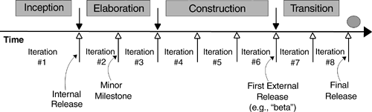
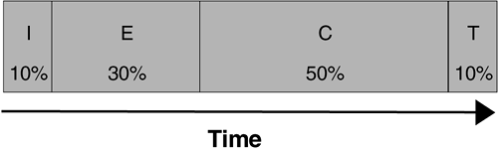
How to Divide the Time?

Slide 10
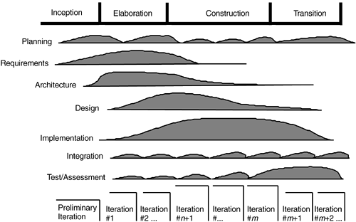
What Should We Do?
The workflow of each iteration contains the activities of requirements elicitation and analysis, of design and implementation, and of integration and test, not necessarily in this order.
From one iteration to the next and from one phase to the next, the emphasis on the various activities changes.

Slide 11
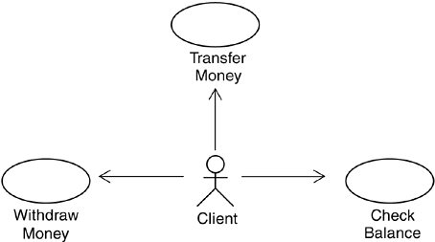
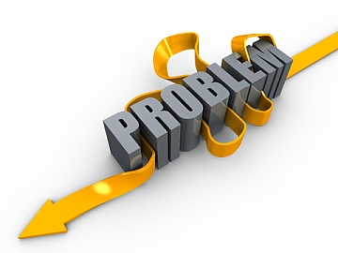
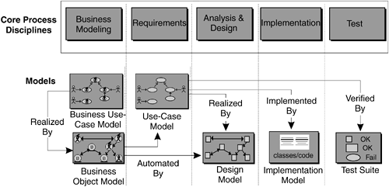
What Should We Create First?
The use-case modeling is one method of understanding and modeling the problem recommended by the Rational Unified Process
The use cases defined for a system are the basis for the entire development process

Slide 12
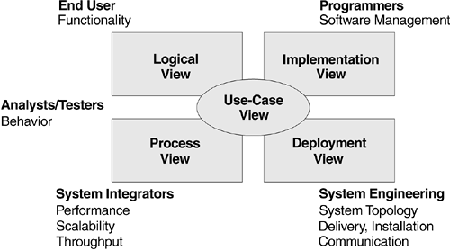
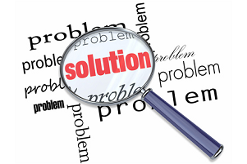
What is the Second Artifact?
System architecture is used in the Rational Unified Process as a primary artifact for conceptualizing, constructing, managing, and evolving the system under development.
Architecture is a complex concept that is best represented by multiple, coordinated architectural views.

Slide 13
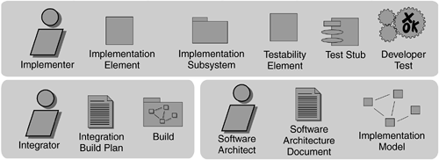
Any More Artifacts?
An artifact is a piece of information that is produced, modified, or used by a process. Artifacts are the tangible products of the project: the things the project produces or uses while working toward the final product.
Business Vision
Software Requirement
Software Architecture Document
Test Plan
Configuration Management Plan
Risk Management Plan
Iteration Plan
Iteration Assessment
Artifacts are used as input by roles to perform an activity and are the result or output of such activities.

Slide 14
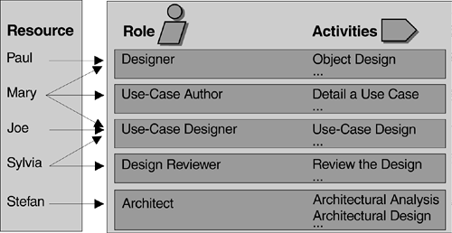
Who Will Create the Artifacts?
A role defines the behavior and responsibilities of an individual or of a group of individuals working together as a team.
The behavior is expressed in terms of activities the role performs
The responsibilities of each role are usually expressed in relation to certain artifacts that the role creates, modifies, or controls.
An activity is a unit of work that an individual in that role may be asked to perform and that produces a meaningful result in the context of the project.

Slide 15
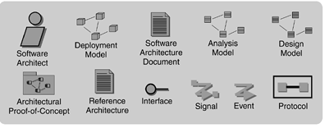
RUP Roles
Analyst roles
Business-Process Analyst
System Analyst
Requirements Specifier
Developer roles
Software Architect
Designer
Implementer
Tester roles
Test Designer
Tester
Manager roles
Project Manager
Process Engineer
Management Reviewer
Production and support roles
System Administrator

Slide 16
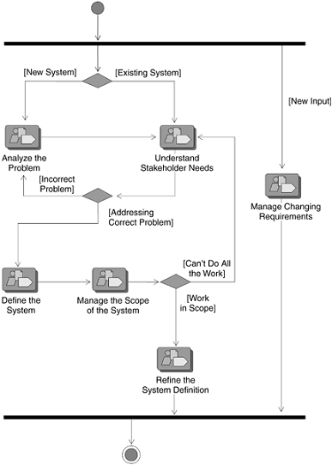
How to Create An Artifact?
A workflow is a sequence of activities that produces a result of observable value.

Slide 17
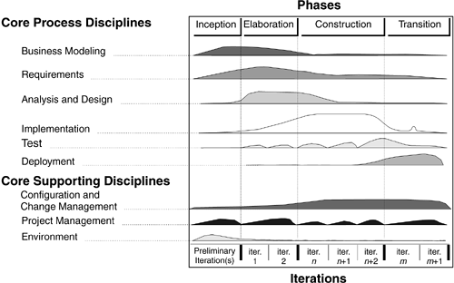
How Detailed Should a Workflow Be?
Core workflows, associated to each discipline
Workflow details, to refine the core workflow
Iteration plans
Disciplines are natural groupings of process activities, roles, and artifacts.

Slide 18
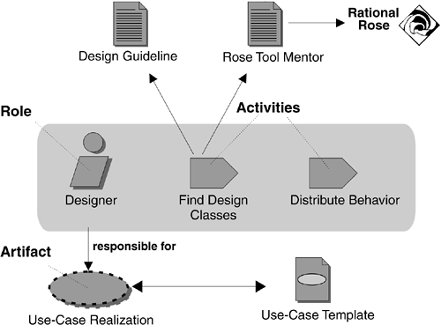
I Still Do Not Know How to Do It
Guidelines are rules, recommendations, or heuristics that support activities and steps, describe well-formed artifacts.
Tool mentors show you how to perform the steps using a specific software tool.
Guidelines
Templates
Tool mentors
Concepts
Guidelines, templates, and tool mentors complement the description of the process by providing detailed guidance to the practitioner.

Slide 19
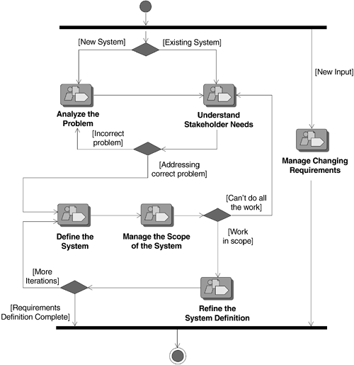
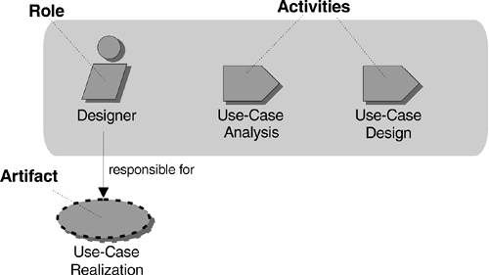
How About My Process?
The Rational Unified Process model is built on five fundamental elements:
Roles: the who
Activities: the how
Artifacts: the what
Workflows: the when
Disciplines: the "container" for the preceding four kinds of element

Slide 20
What Is the RUP?
The Rational Unified Process is a software engineering process.
It provides a disciplined approach to assigning tasks and responsibilities within a development organization.
The Rational Unified Process is a process product.
It is developed and maintained by Rational Software and integrated with its suite of software development tools.
The Rational Unified Process is also a process framework
that can be adapted and extended to suit the needs of an adopting organization.

Slide 21


Slide 22
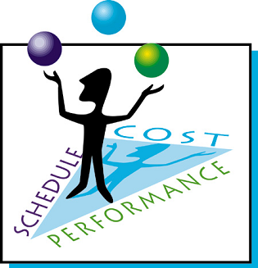
The Project Management Discipline

Slide 23

Purpose
To provide a framework for managing software-intensive projects
To provide practical guidelines for planning, staffing, executing, and monitoring projects
To provide a framework for managing risk

Slide 24
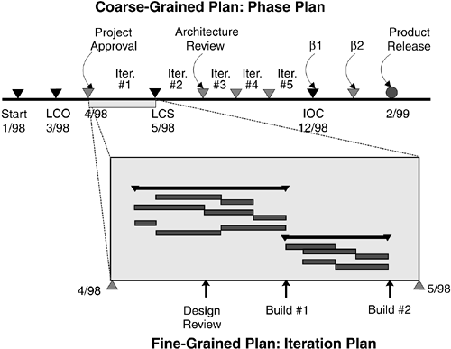
Planning an Iterative Project

Slide 25
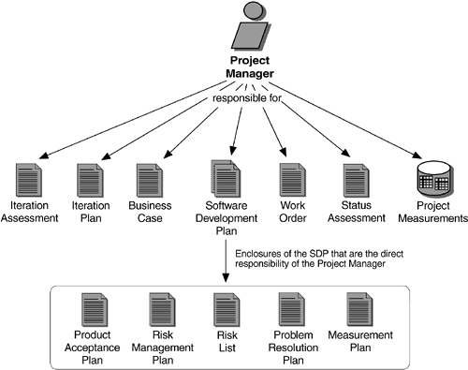
Roles and Artifacts
Roles and Artifacts

Slide 26
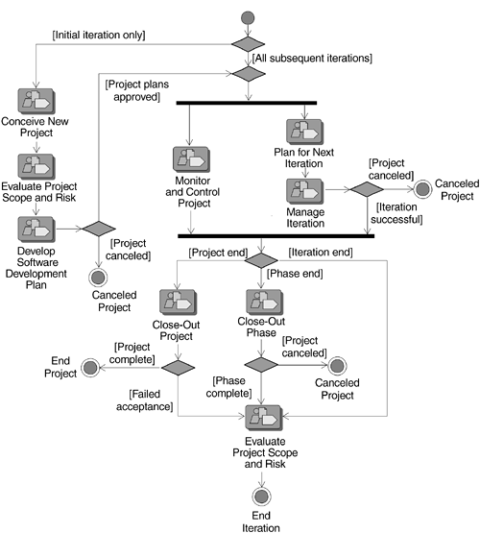
Workflow in Project Management

Slide 28
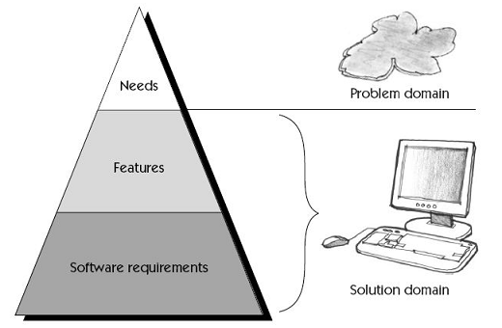
The Requirements Discipline

Slide 29
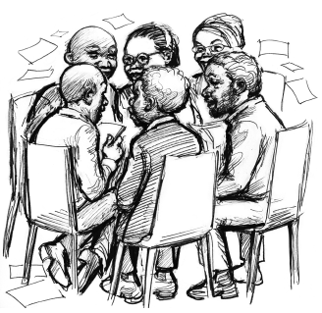
Purpose
To establish and maintain agreement with the customers and other stakeholders on what the system should do—and why!
To provide system developers with a better understanding of the system requirements
To define the boundaries of (delimit) the system
To provide a basis for planning the technical contents of iterations
To provide a basis for estimating cost and time to develop the system
To define a user interface for the system, focusing on the needs and goals of the users

Slide 30
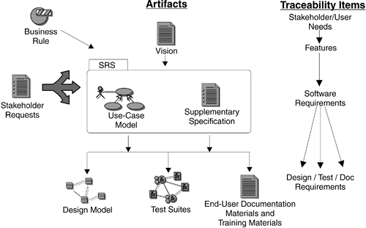
Capturing and Managing Requirements

Slide 31
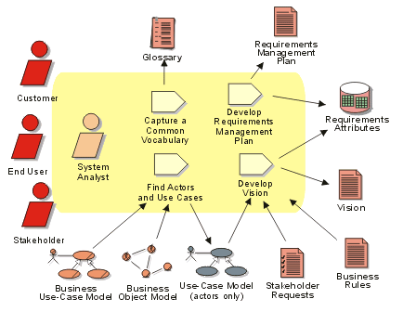
Roles and Artifacts

Slide 32

Requirements Workflow

Slide 34

The Implementation Discipline

Slide 35

Purpose
To define the organization of the code in terms of implementation subsystems organized in layers
To implement classes and objects in terms of components (source files, binaries, executables, and others)
To test the developed components as units
To integrate into an executable system the results produced by individual implementers or teams

Slide 36
Roles and Artifacts

Slide 37
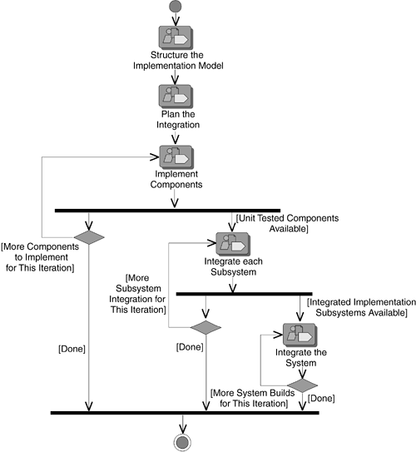
Implementation Workflow

Slide 39
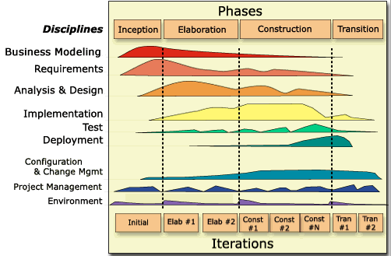

Any More Disciplines?

Slide 41

RUP Practices
Iterative development
Requirements management
Architecture and use of components
Modeling and the UML
Configuration and change management
Use-Case-Driven development
Process configuration
Tools support

Slide 42

RUP Values
Project-oriented
Risk and value-driven
Clear vision
Well-defined process

Slide 43

Pitfalls
There's a lot of really good stuff here. We need to do it ALL.

Slide 44

Thank You for Your Time

